Slide 1
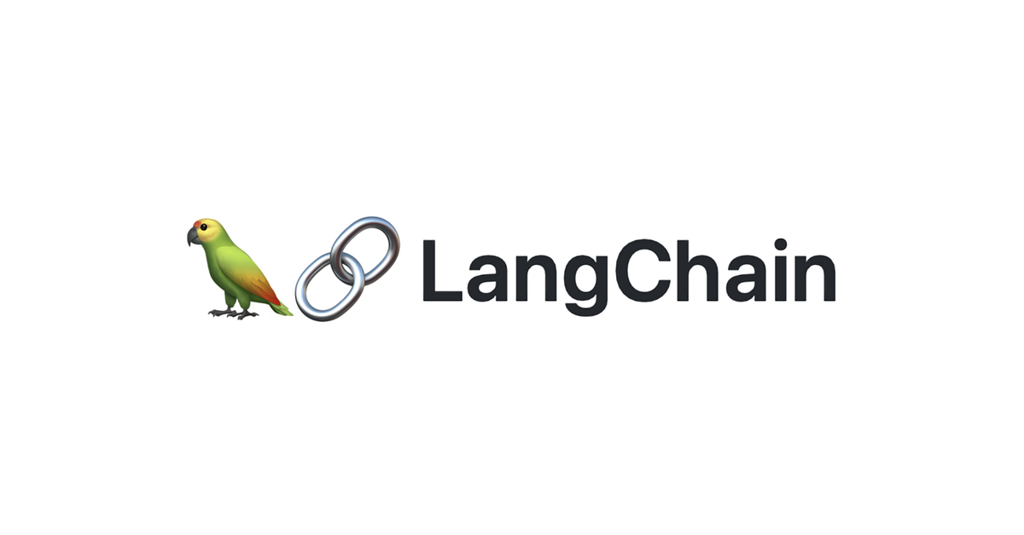
RAG from scratch: Query Translation
(RAG-Fusion)
Lance Martin
Software Engineer, LangChain
@RLanceMartin
Notes:
Query rewriting is a popular strategy to improve retrieval. RAG-fusion is an approach that re-writes a question from multiple perspectives, performs retrieval on each re-written question, and performs reciprocal rank fusion on the results from each retrieval, giving a consolidated ranking.
Slides:
https://docs.google.com/presentation/d/1EwykmdVSQqlh6XpGt8APOMYp4q1CZqqeclAx61pUcjI/edit?usp=sharing
Code:
https://github.com/langchain-ai/rag-from-scratch/blob/main/rag_from_scratch_5_to_9.ipynb
Reference:
https://github.com/Raudaschl/rag-fusion

Slide 2
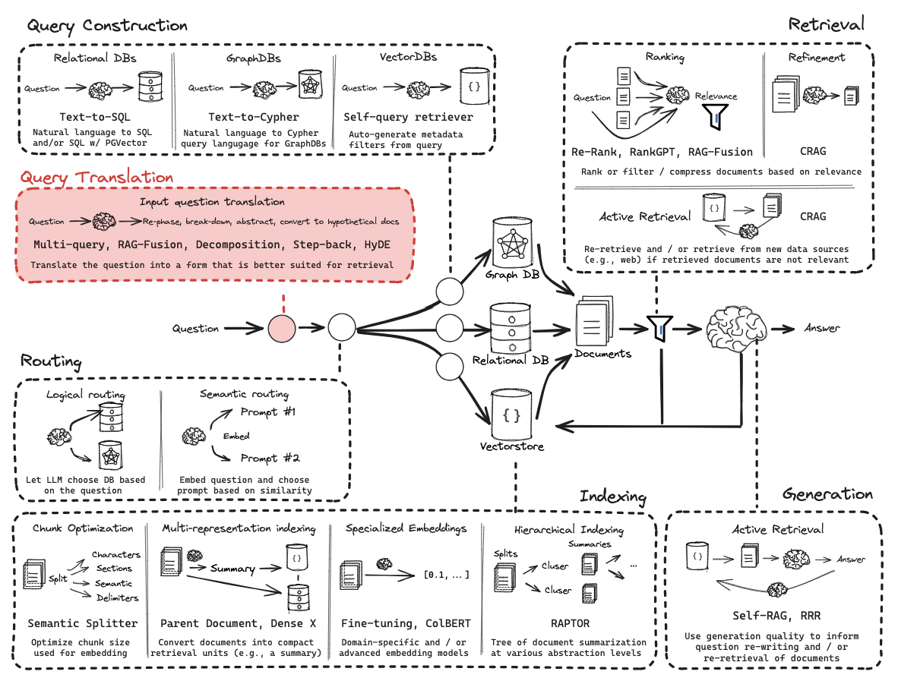
Query Translation

Slide 3
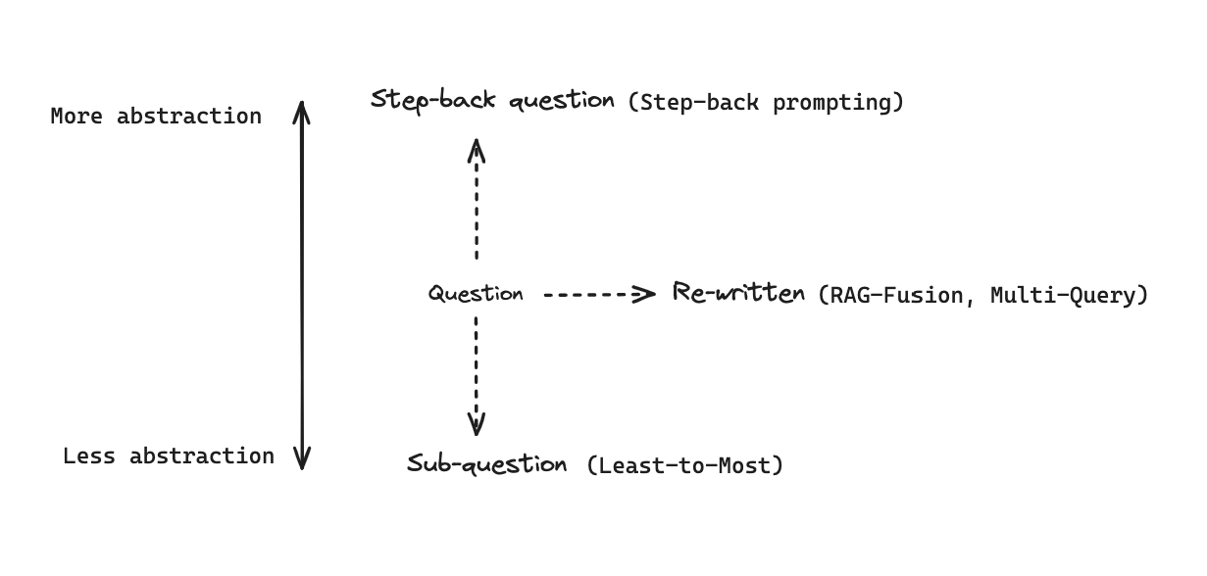
General approaches to transform questions
https://github.com/Raudaschl/rag-fusion

Slide 4
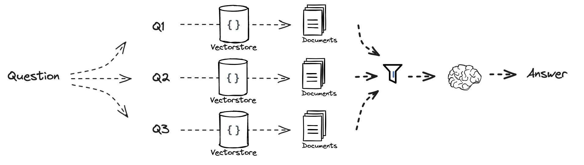
Intuition: Improve search, produce consolidated ranking

Slide 5
Code walk-through

